Slide 1
Tn5-based WGBS of primary alpha and beta cells
Verda Agan

Slide 2
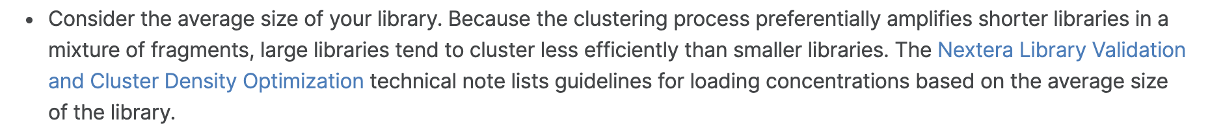
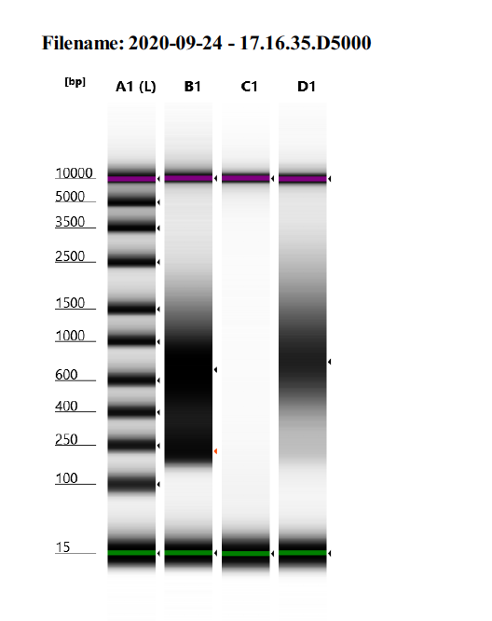
After BS treatment, fragments of the sequencing library should should have a size range of 200-600 bp with a peak at about 300-400 bp.
B1: Here, we obtained DNA fragments in the 200-600 bp range, but there were more 200 and 600 bp fragments than 300/400 bp fragments.
How can we improve fragmentation?
Start with less input DNA in order to get a smaller library size. I used 50 ng this first time.
“T-WGBS is particularly suited for low input DNA amounts and has been optimized for 10-30 ng of human or mouse input DNA.” (Nature Protocols)
Increase tagmentation time (and/our amount of enzyme?).
Troubleshoot bisulfite conversion step.
See next slide.
Previously used EZ DNA Methylation Kit and didn’t see cytosine to uracil conversion. Try again?
D1: Here, peak is ~700 bp. How can we skew distribution towards smaller fragment sizes?
Notes:
https://support.illumina.com/bulletins/2016/06/how-to-achieve-more-consistent-cluster-density-on-illumina-sequencing-platforms.html

Slide 3
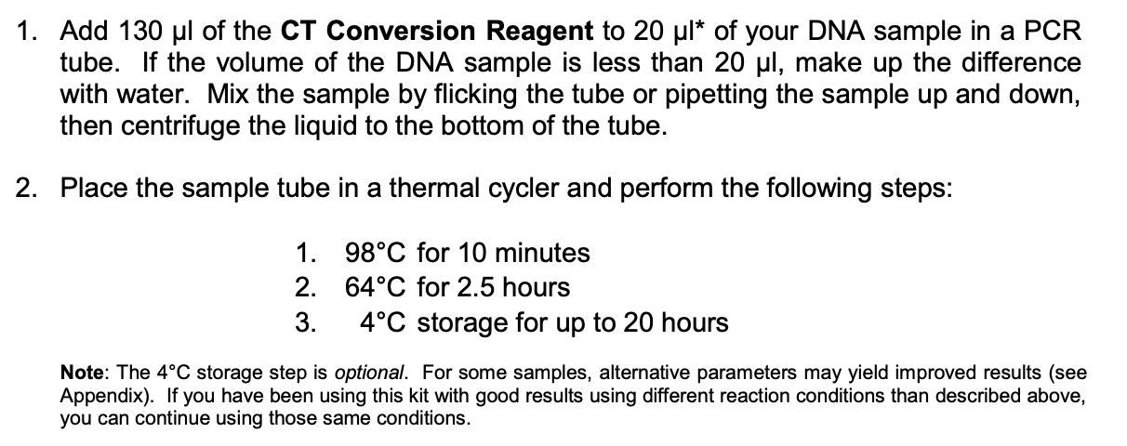
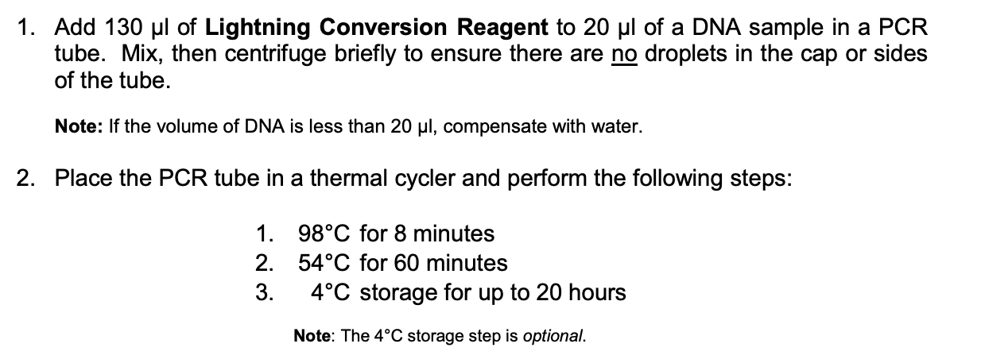
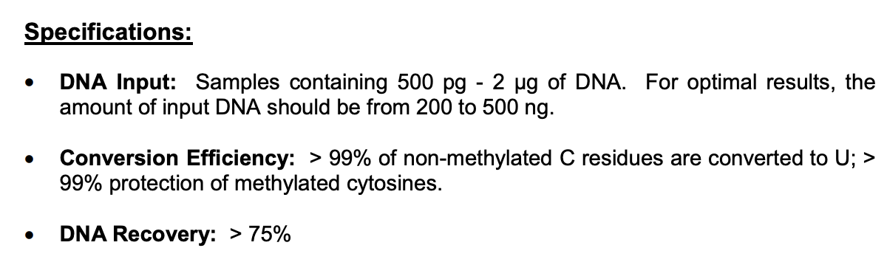
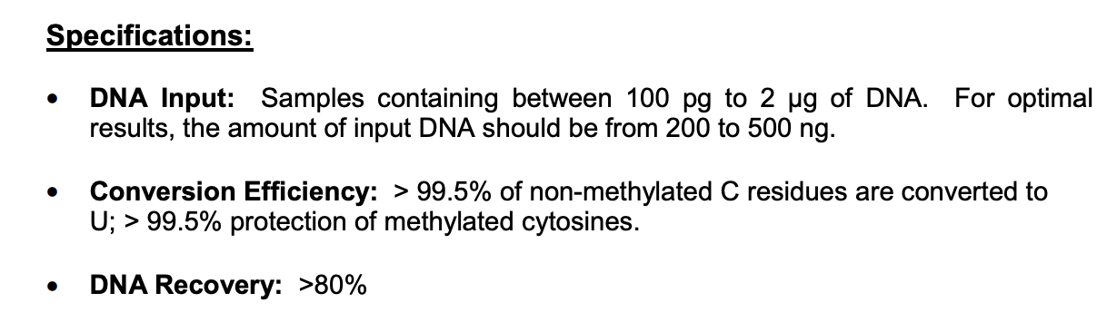
Troubleshooting BS conversion step
EZ DNA Methylation Gold Kit
EZ DNA Lightning Kit
Longer incubation time and lower heat/variable cycling results in longer fragment sizes and less DNA degradation. Alternative options also suggest longer DNA fragments will be produced.
Shorter incubation time and higher heat results in shorter fragment sizes and more DNA degradation (Lindsey tested).
Notes:
Lightning kit (Lightning Conversion Reagent) uses ammonium bisulfite; gold uses sodium bisulfite (CT conversion reagent). Sodium bisulfite is less damaging

Slide 4
Troubleshooting BS conversion step
My options are to:
A) Test different amounts of input DNA (10, 25, 30, etc..)
B) Use EZ DNA Methylation Gold Kit.
C) Use EZ DNA Methylation Gold Kit but use the thermocycler conditions recommended in the EZ DNA Methylation (Lightning) Kit.

Slide 5
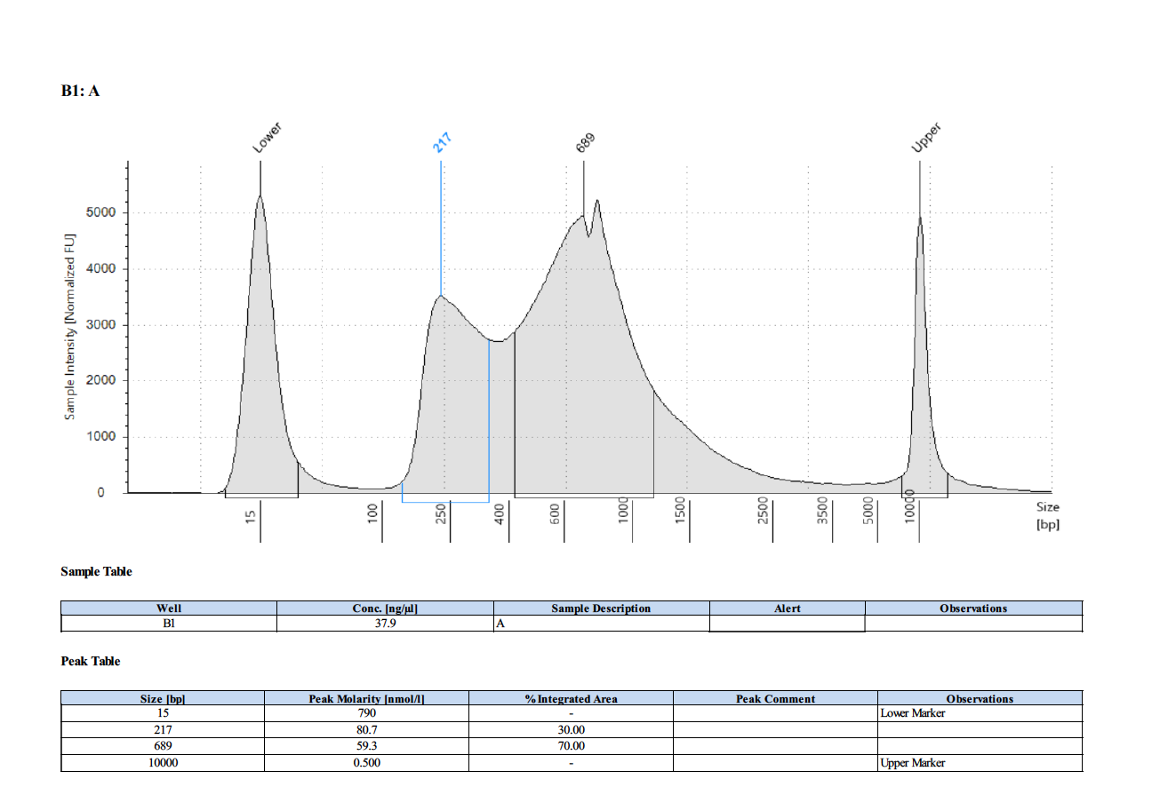

Slide 6
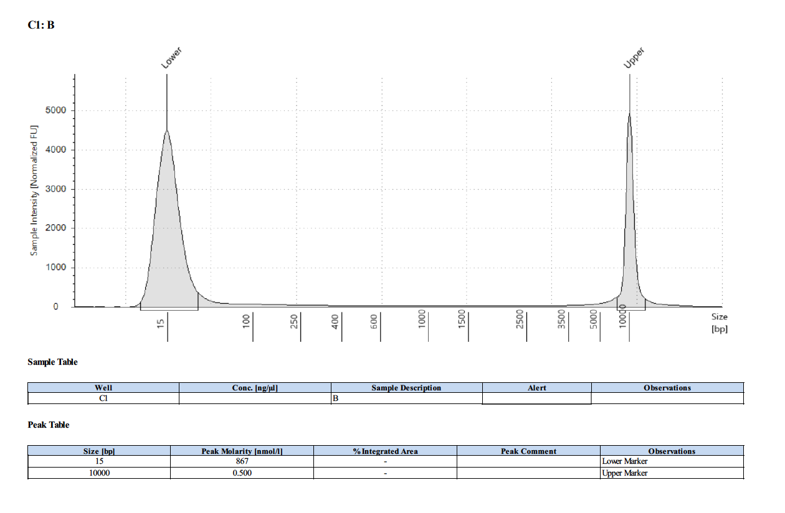

Slide 7
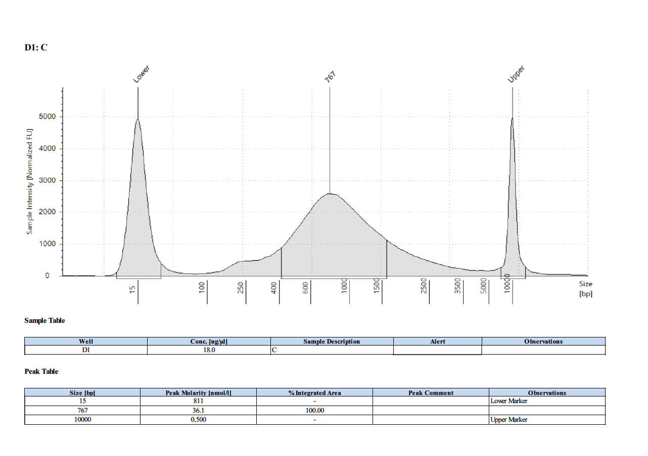

Slide 8
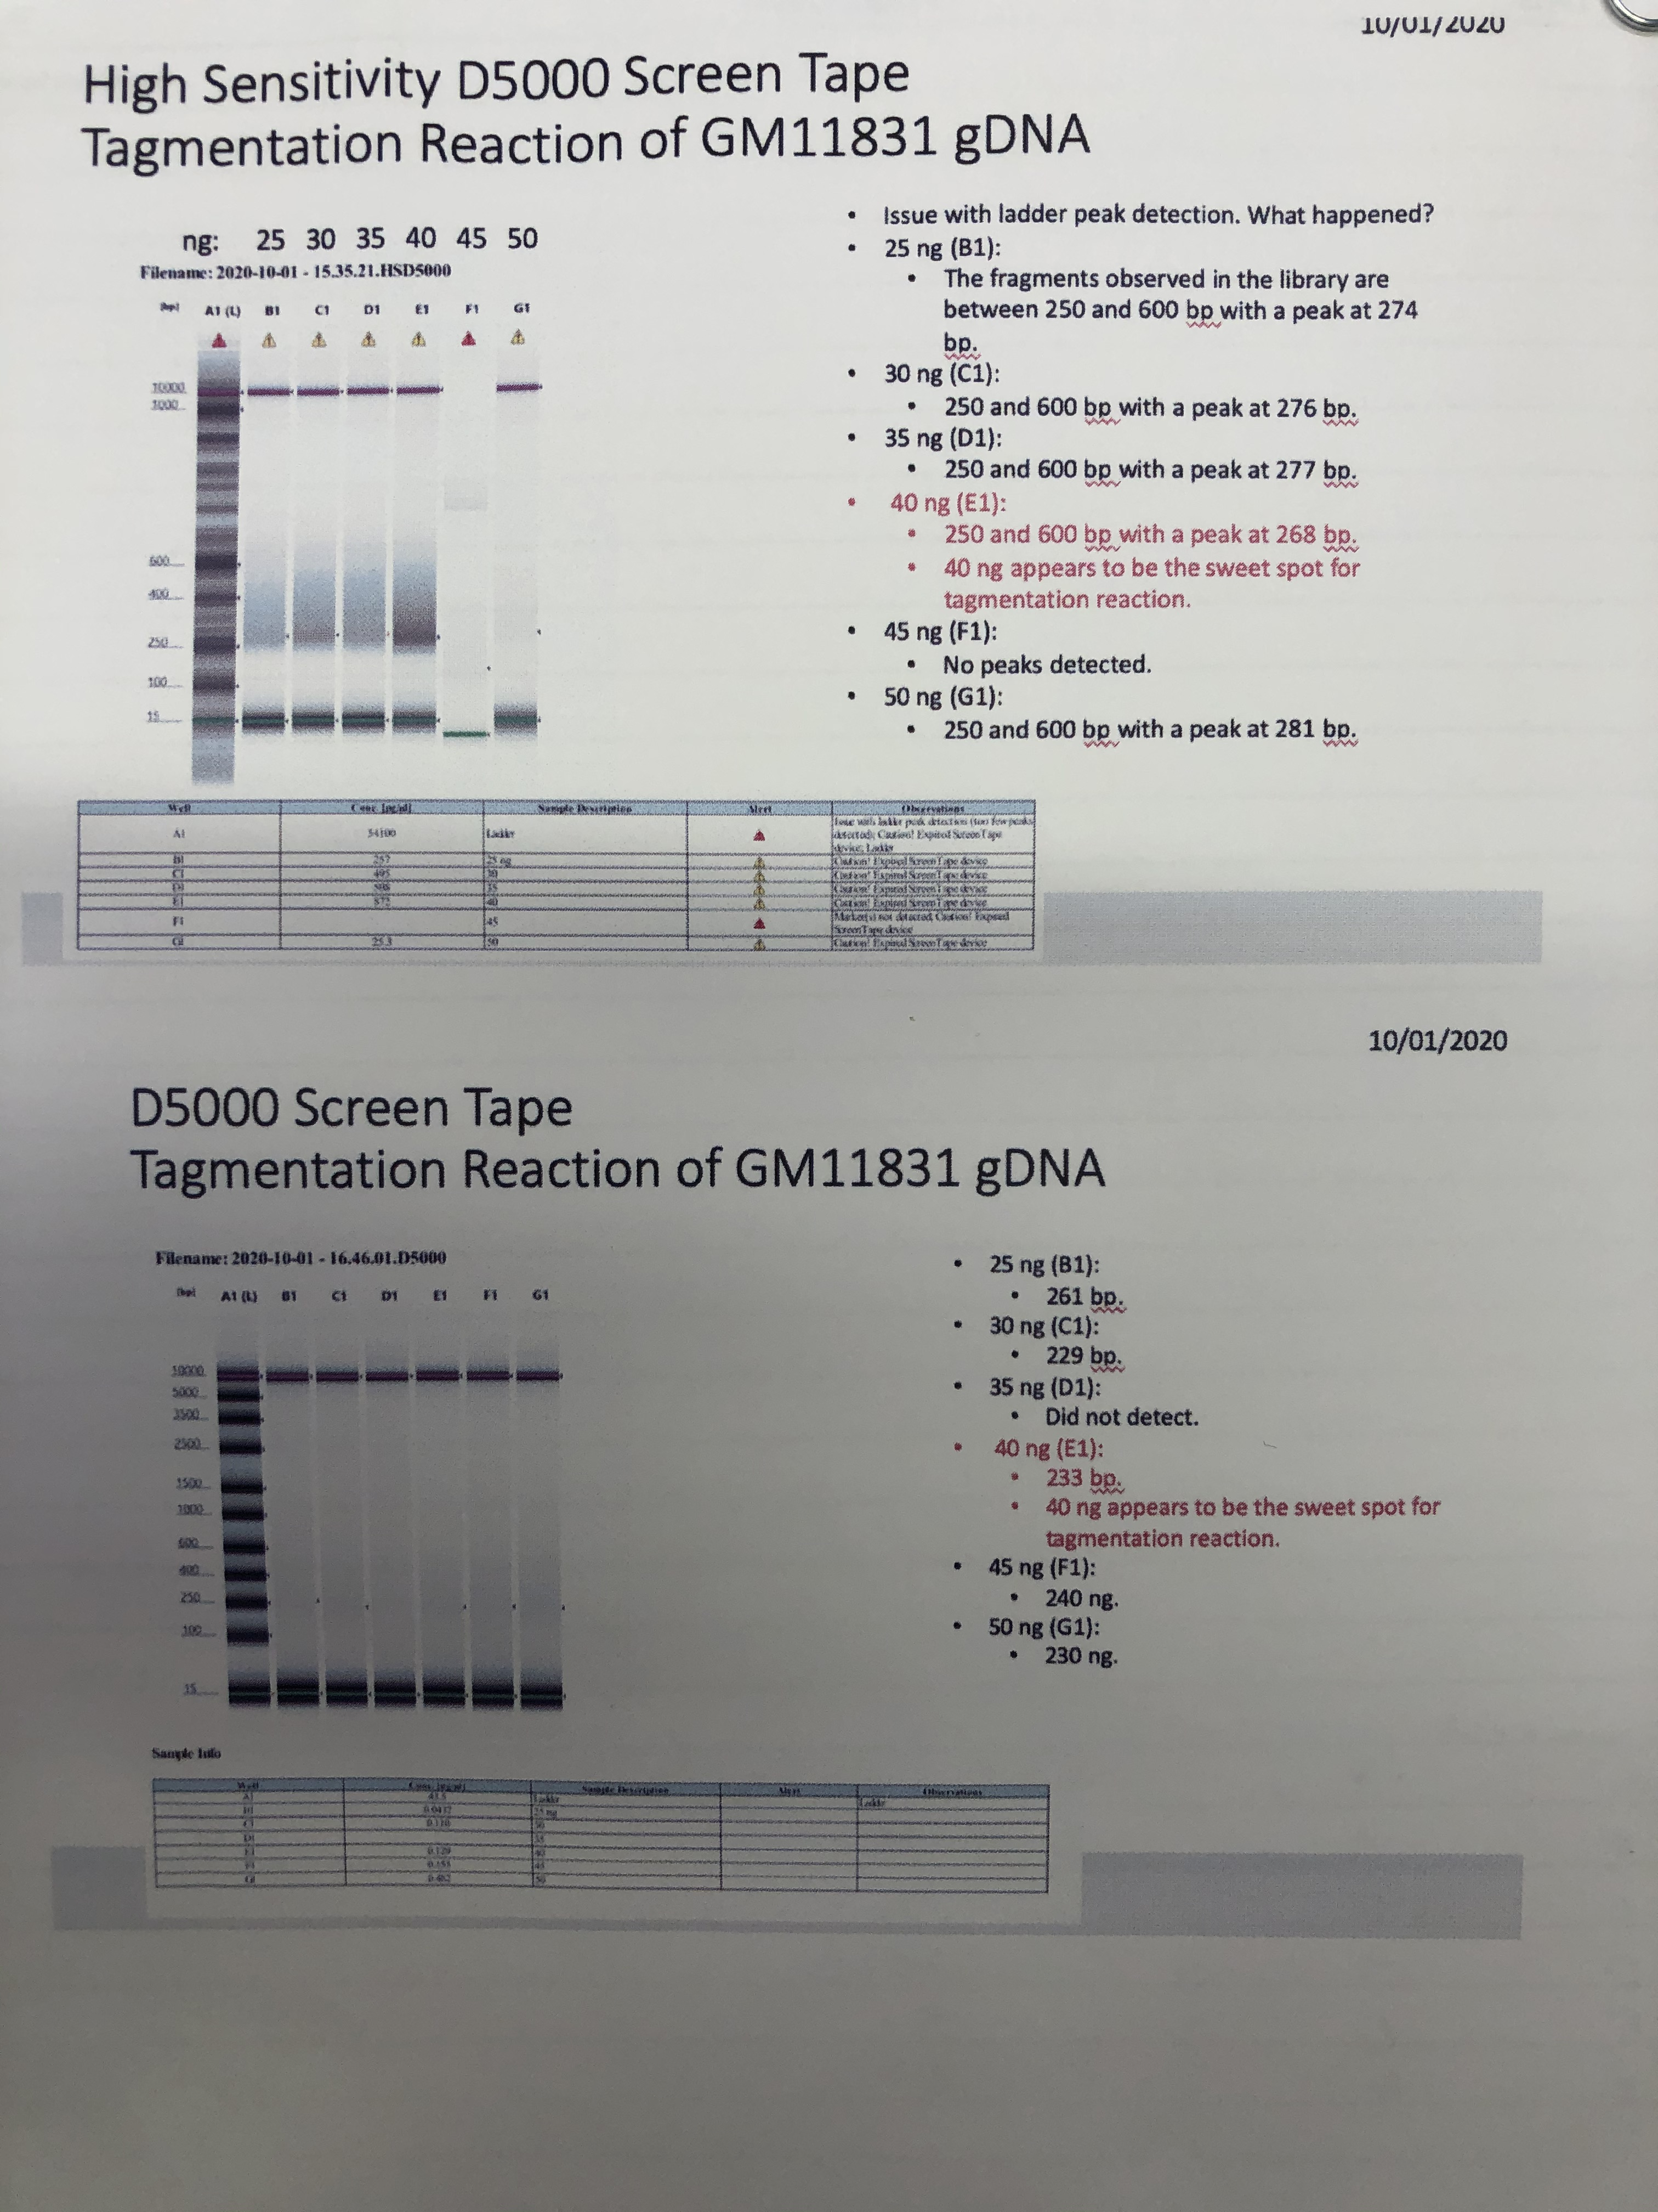

Slide 9
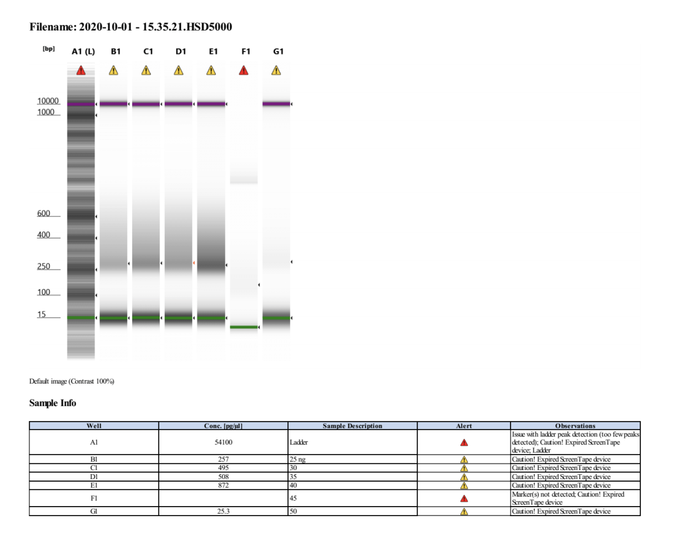
High Sensitivity D5000 Screen Tape Tagmentation Reaction of GM11831 gDNA

Slide 11
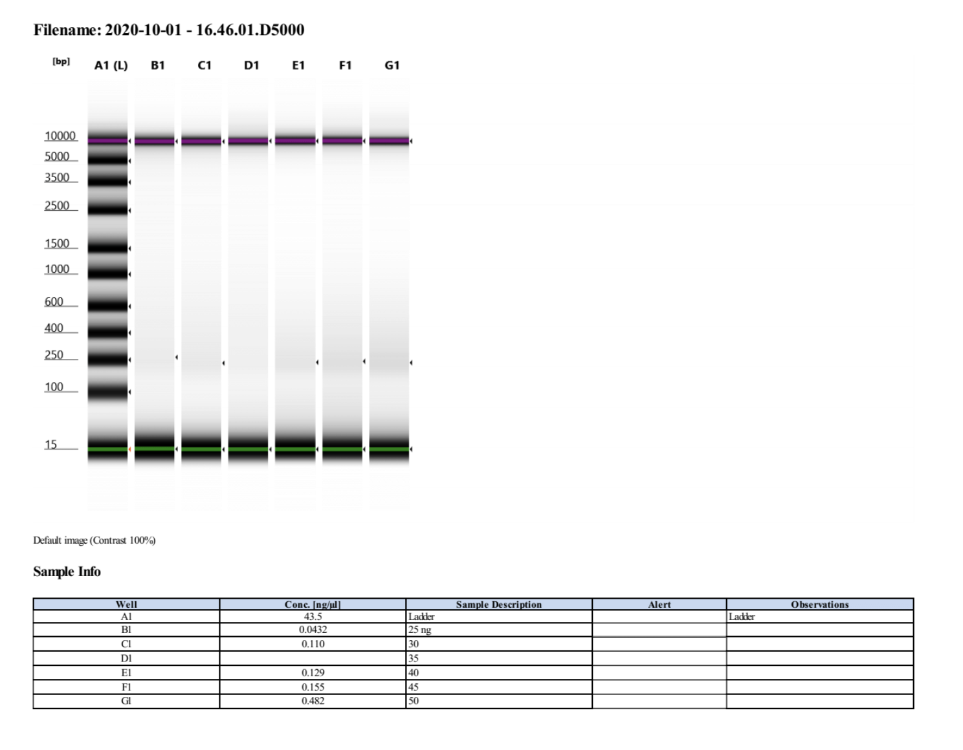
D5000 Screen Tape Tagmentation Reaction of GM11831 gDNA

Slide 12
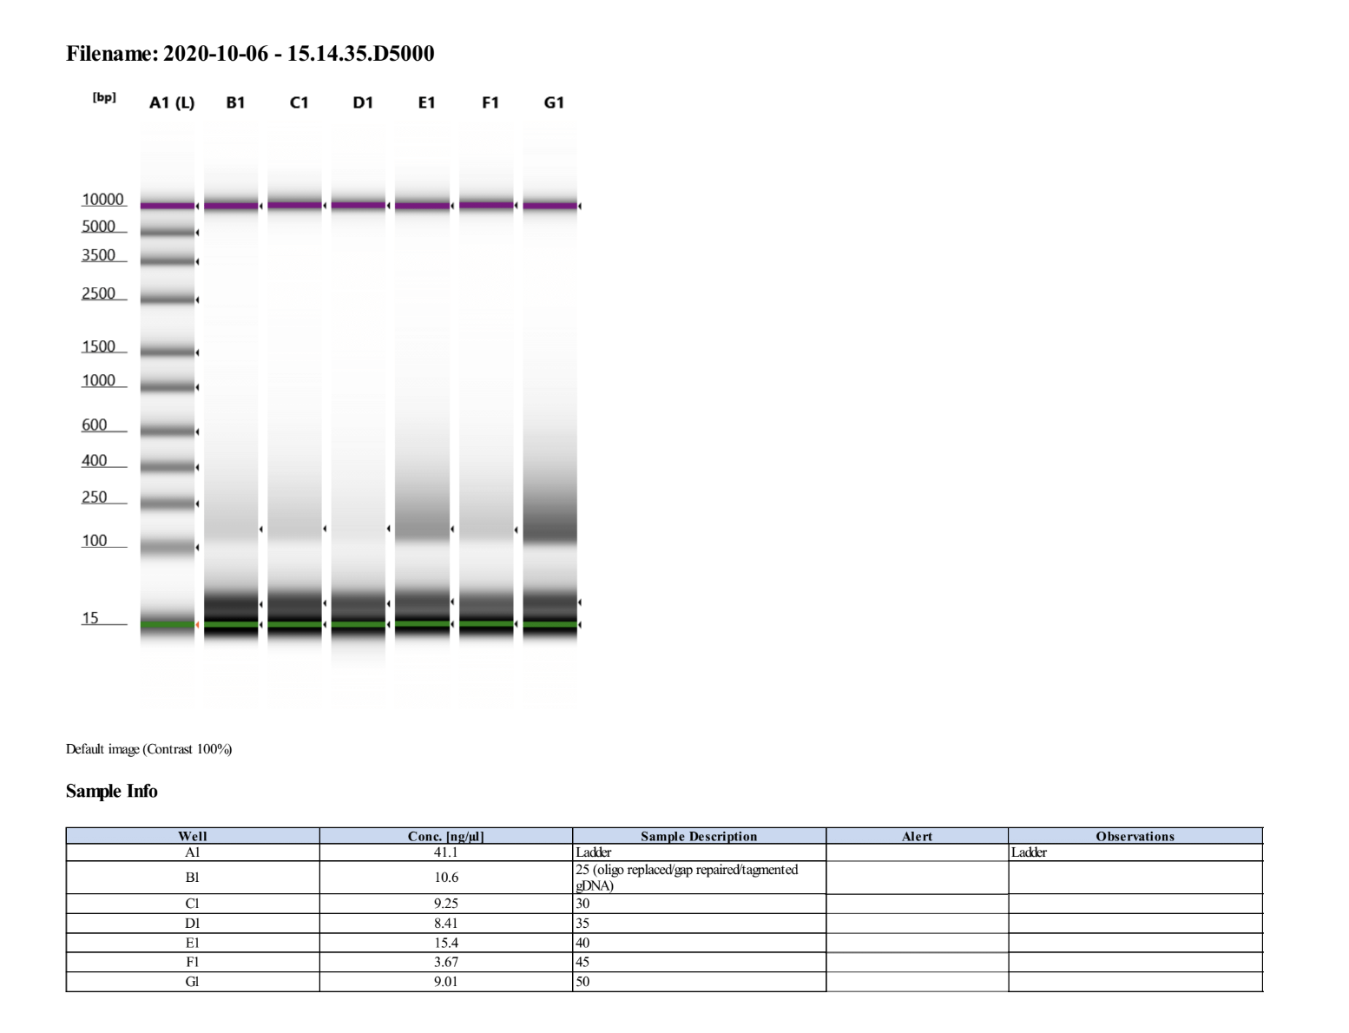
DNA library post-gap repair and oligo gap displacement of GM11831 gDNA

Slide 13
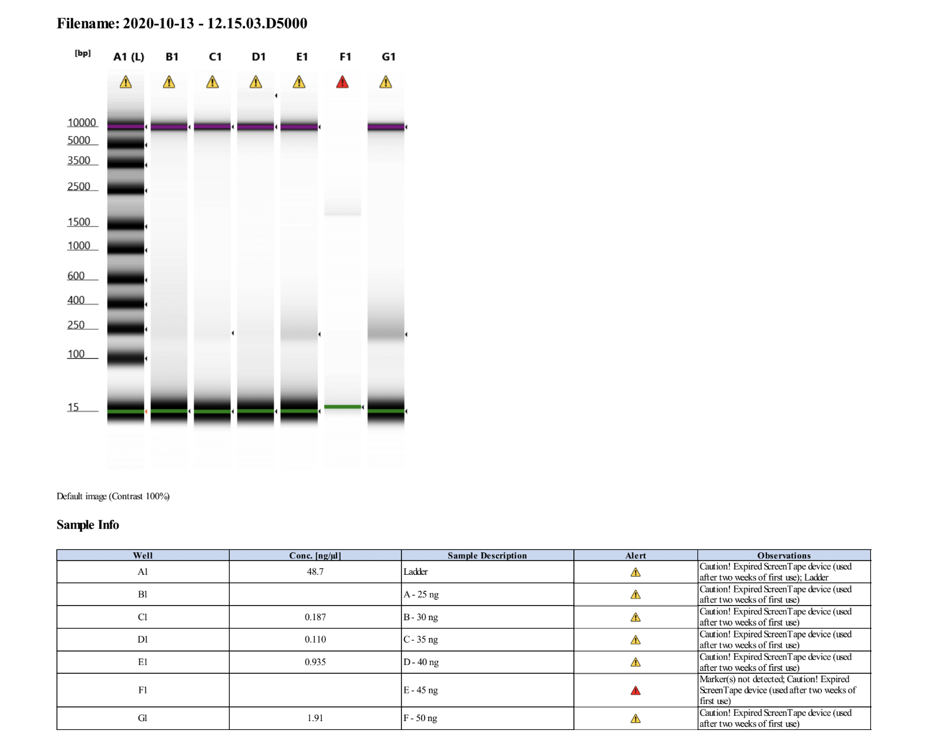
Bisulfite DNA library post-amplification (D5000) of GM11831 gDNA

Slide 14
Next steps for Tn5-based BS-seq
Test larger DNA input sizes at 1:1 Tn5:adapter enzyme ratio:
60 ng
70
75
80
85
90
95
100

Slide 15
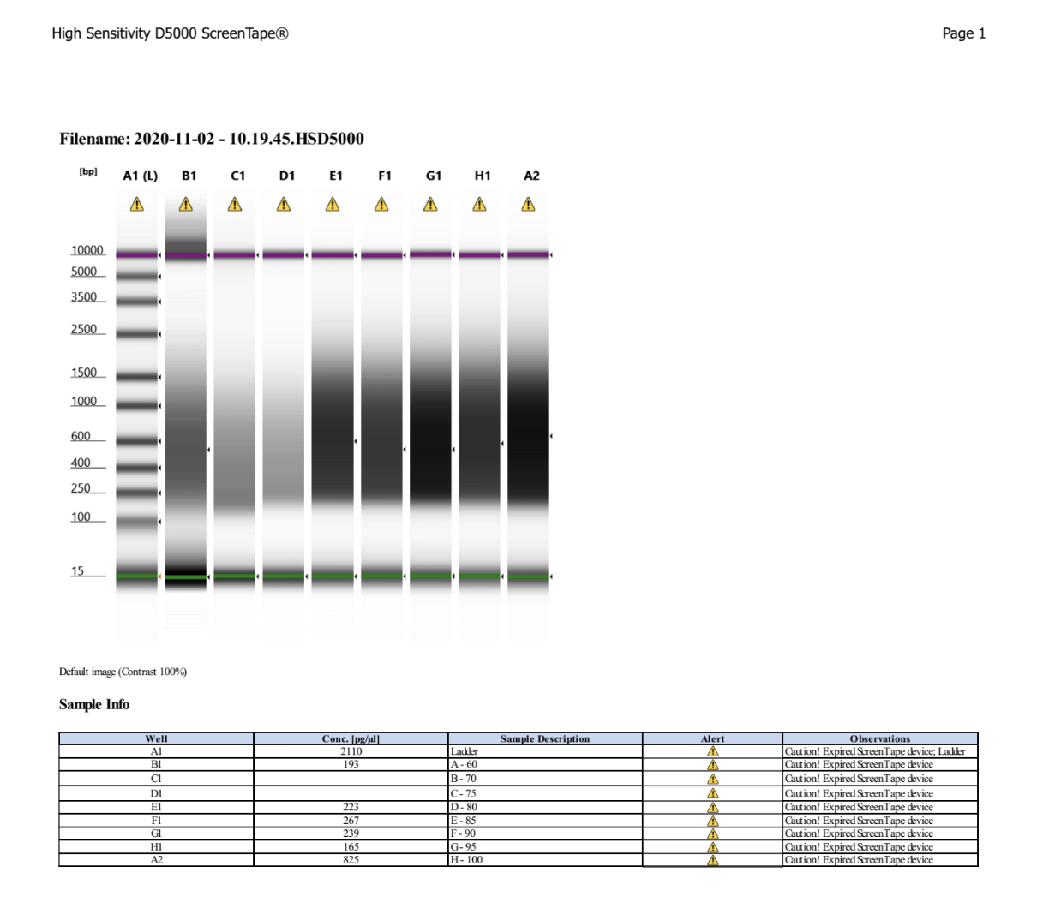
High Sensitivity D5000 Screen Tape Tagmentation Reaction of GM11831 gDNA

Slide 16
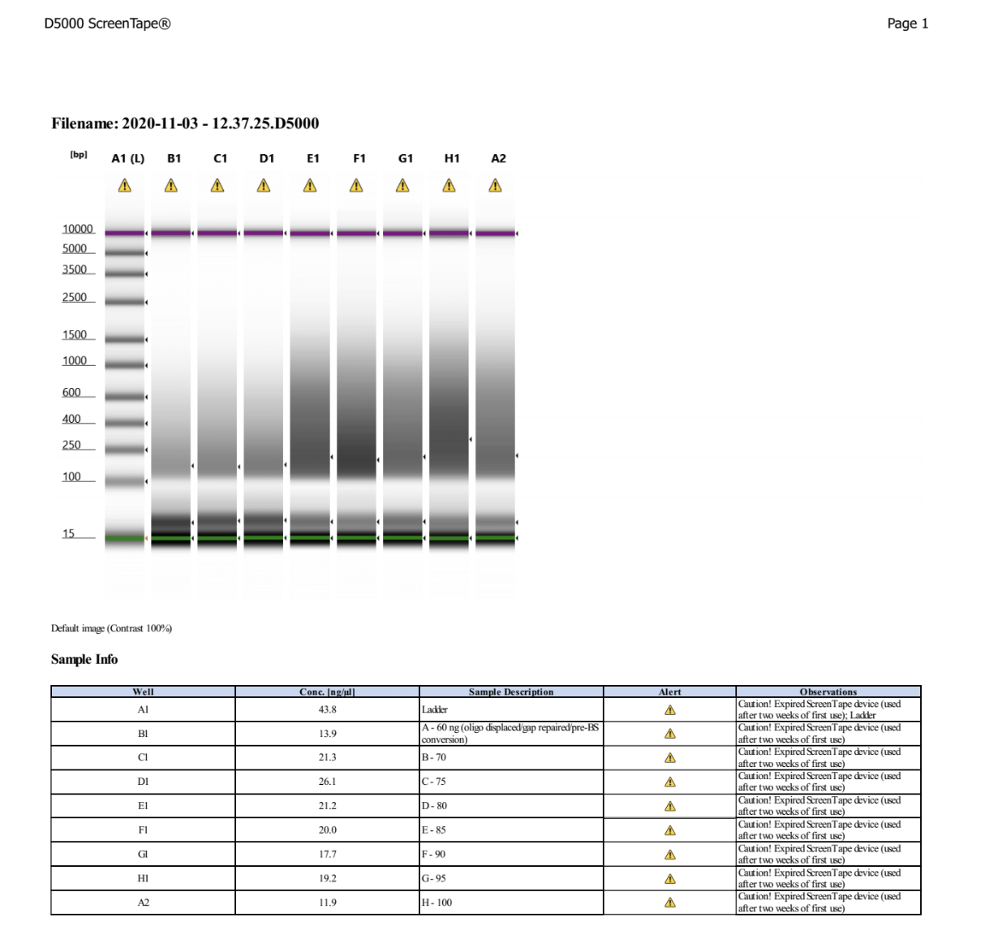
DNA library post-gap repair and oligo gap displacement of GM11831 gDNA

Slide 17
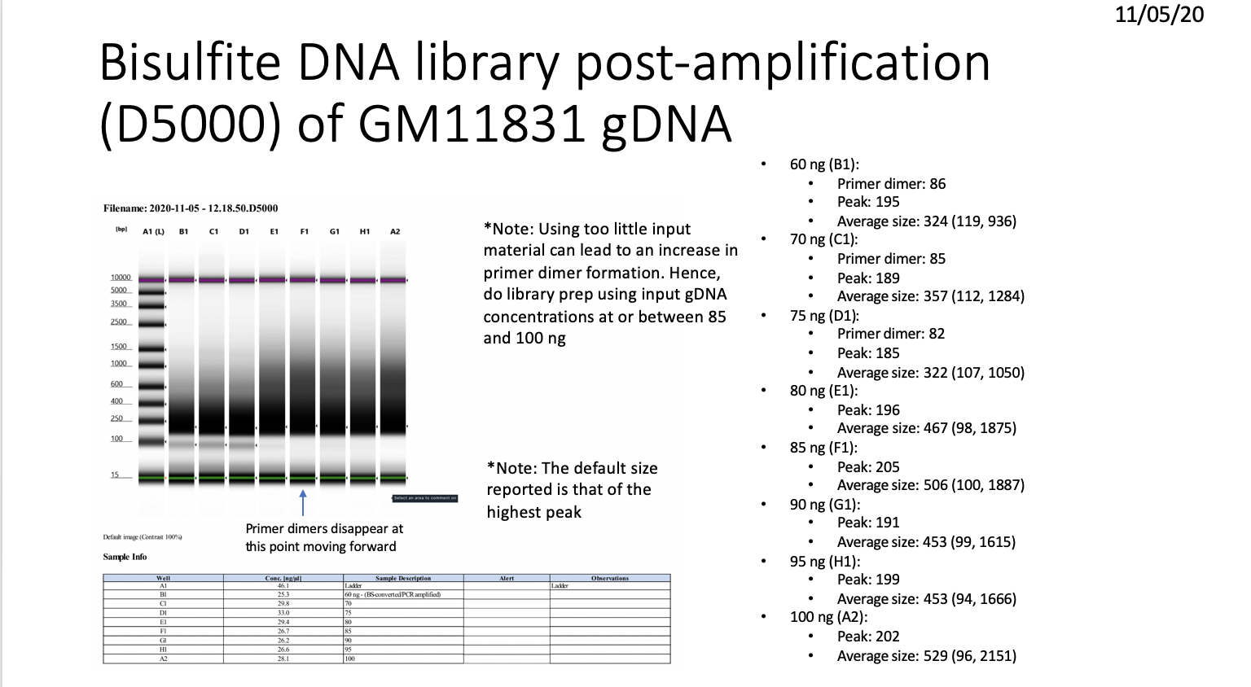

Slide 18
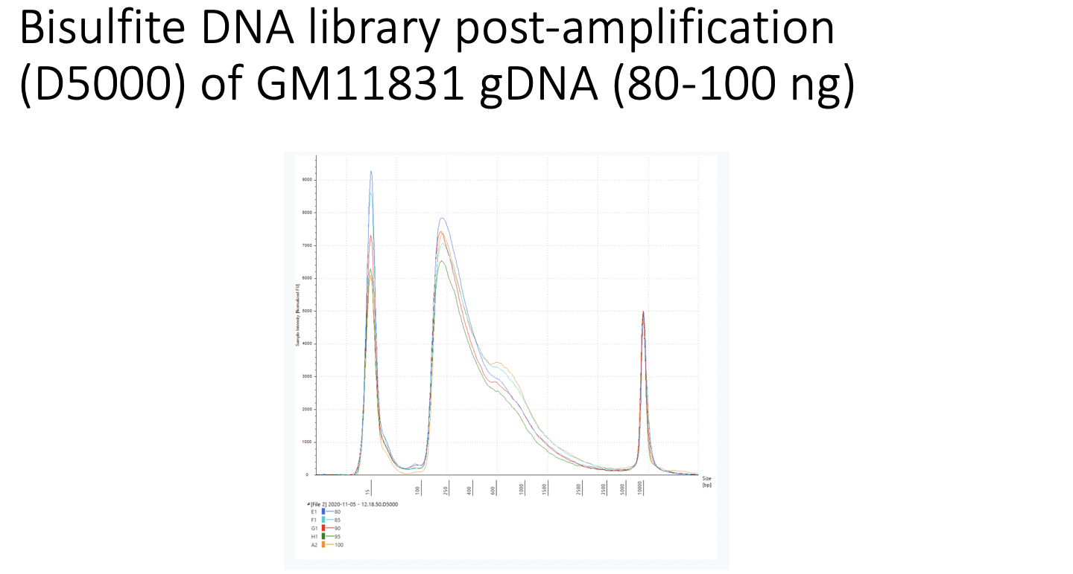

Slide 19
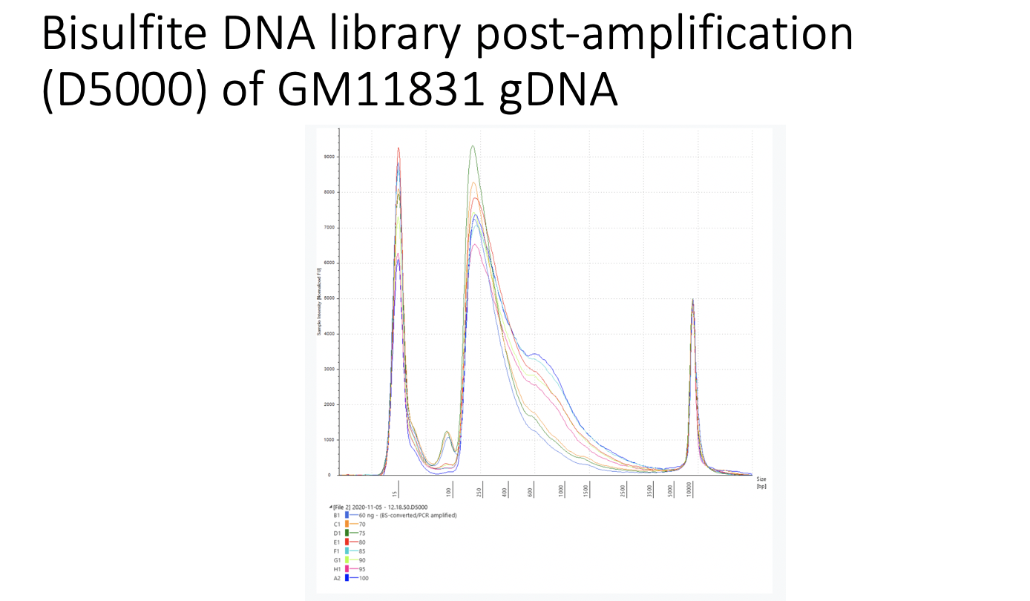

Slide 20
Meeting with Emily 11/23/20
Good input is needed for stoichiometry between DNA and enzyme, maximize size range of DNA
Higher input amount gives better yield
Want good size range. 80 or 85 ng
22 uL, 10 uL sent to Vantage
Vantage takes the DNA and preps another dilution, qPCR to detect # of sequence-able molecules, determine how much to load onto flow cell depending on qPCR results
Sequencing specifications, paired-end, 150 bp each end, NovaSeq, sequence enough to get 10X coverage, 250-300 million reads
2 week turn around from Vantage
Wait and submit after the holiday
Notes:
50,000 HMRs shared, many are promoters, use UCSC genome browser tracks to just look at data
UCSC requires a URL, requires that you deposit data (bb or bigBed files) onto the server
IGV browser, download software onto IGV, use bigwig files to look in IGV browser, allows you to look at the same location across all cell lines
Use IGV browser for primary alpha and beta cell lines that don't have shared HMRs, pick your favorite gene, look at methylation there

